Slide 1
Stack Non-generic Collection In C#
Presenter: mohammad adil

Slide 2
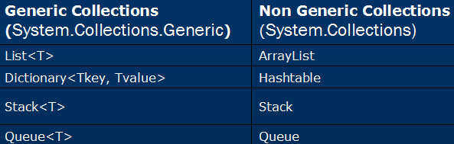

Slide 3
Collections In C#
All non-generic collection classes have these features.
1. They can store homogeneous elements as well as heterogeneous elements.
2. They are not type safe.
3. It can automatically resize dynamically (Auto Resizing).

Slide 4

Stack Meaning
Stack means pile of objects.
Another meaning Dher Lagana.

Slide 5
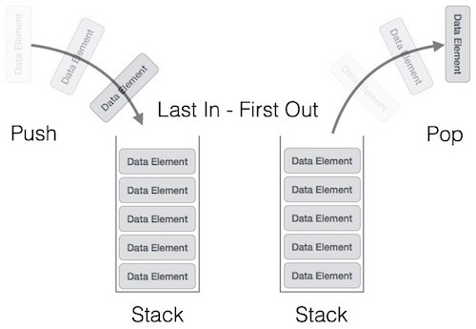
Stack Non-generic Collection In C#
LIFO

Slide 6
STACK NON-GENERIC COLLECTION IN C#
C# includes a special type of collection which stores elements in LIFO style (Last In First Out).
C# includes a generic and non-generic Stack. Here, you are going to learn about the non-generic stack.
Stack allows null value and also duplicate values. It provides a Push() method to add a value and Pop() or Peek() methods to retrieve values.

Slide 7
STACK NON-GENERIC COLLECTION IN C#
Stack allows null value and also duplicate values.
A stack is used to create a dynamic collection which grows, according to the need of your program.
The capacity of a Stack is the number of elements the Stack can hold. As elements are added to a Stack, the capacity is automatically increased as required through reallocation.
In a stack, you can store elements of the same type or different types.

Slide 8
STACK NON-GENERIC COLLECTION IN C#
The Stack class implements the IEnumerable, ICollection, and ICloneable interfaces.
When you add an item in the list, it is called pushing the element.
When you remove it, it is called popping the element.

Slide 9
Important Properties And Methods Of Stack
Count Returns the total count of elements in the Stack.
Push Inserts an item at the top of the stack.
Peek Returns the top item from the stack.
Pop Removes and returns items from the top of the stack.
Contains Checks whether an item exists in the stack or not.
Clear Removes all items from the stack.

